Slide 1


Slide 2
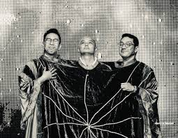
ORACLE IN A NUTSHELL
CLIENT
DATABASE
CLIENT APPLICATION

Slide 3
ORACLE CLIENT being used by
ORACLE CLIENT
digital file
Us
The users
The developers
The query lordszxc
It is not an application but
A plain files is installed on our pc
It has all the setting we need to connect to an oracle database
If it’s not an application, then how can we utilize the
ORACLE CLIENT?

Slide 4

ORACLE CLIENT APPLICATION

Slide 5

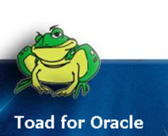
Toad for oracle

Slide 6

